Slide 1

Day 1 (02/11/2016)
D-Code

Slide 2
Welcome!
Notes:
(“Good to meet you, I’m Kyle”
“I’m Brandy”
“let’s get started”)

Slide 3
Today’s Goals
Meet the Instructors
Discuss our goals
Meet the team
Discuss our workflow
What is programming?

Slide 4
The Instructors

Slide 5
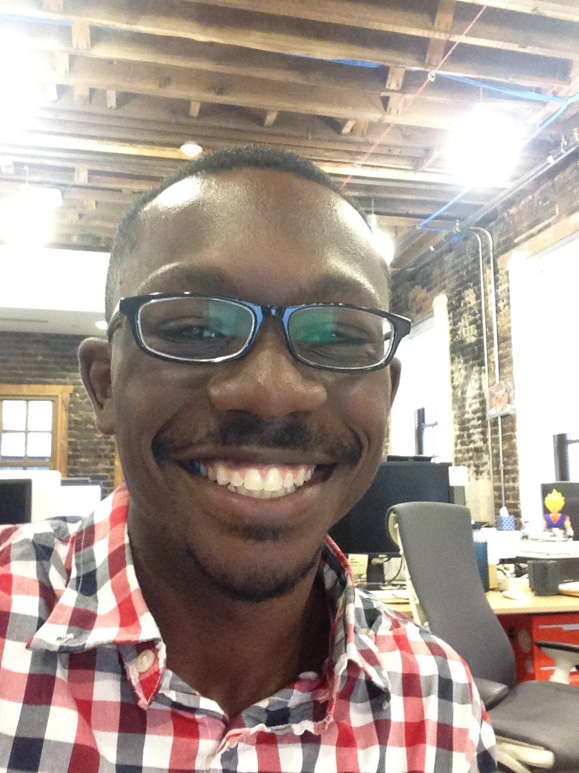
Kyle
Java/Android developer
Grew up in Ohio
Enjoy traveling and learning about different places
Graduated from Princeton
Like cereal, especially Honey Bunches of Oats
Into French hip-hop/pop at the moment

Slide 6
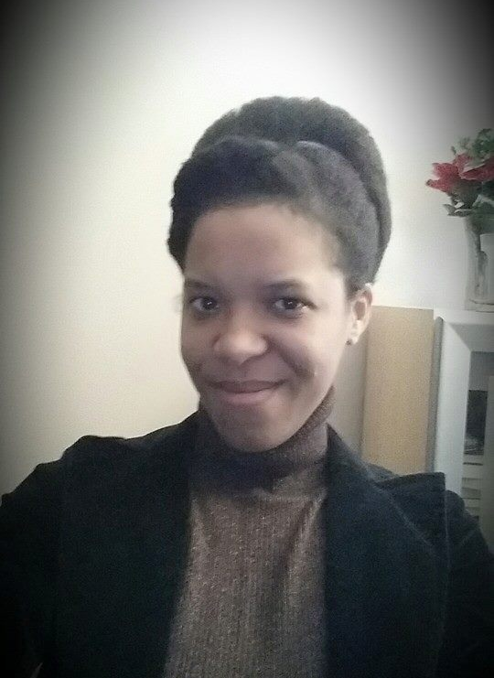
Brandy
Writer of Code (Java)
Writer of Words (Poetry)
Mom of two small humans
Detroit Born and Raised
Halo Mistress Chief (Ubisoft)
Reader of Sci-Fi
Part Android

Slide 7
Today’s Goals
Meet the Instructors
Discuss our goals
Meet the team
Discuss our workflow
What is programming?

Slide 8
Why are we here?

Slide 9
Team Goals
Introduce you to the world of software development
Learn the basics of Javascript, HTML and CSS
Use what we learn to ship something cool

Slide 10
Why are you here?

Slide 11
Individual Goals
A software developer’s most important development is themselves.
Remember that there is always something new to learn and we should be willing to learn something new every chance we get.
You will never know everything…
but you can always google it.

Slide 12
Goal Map
Notes:
In this program, it’ll be clear that only you can make yourself get the knowledge you want. That should be maybe a little scary, but also empowering!
Have students record 3 goals you have for yourself for this class.
Have students record 3 apprehensions they have about meeting their goals.

Slide 13
Today’s Goals
Meet the Instructors
Discuss our goals
Meet the team
Discuss our workflow
What is programming?

Slide 14
Today’s Goals
Meet the Instructors
Discuss our goals
Meet the team
Discuss our workflow
What is programming?

Slide 15
Meet the Team
There are two teams.
Everyone write a fact about themselves and put it in their team’s bag. Then, the teams switch bags.
The first person pulls out a fact and reads it aloud.
Then, they have one chance to guess who the fact belongs to, after deliberating with your team (don’t think too long – you only have 5 seconds).
If they get it right, their team gets a point. (If they get it wrong, don’t give it away yet!)
The other team guesses next. Continue until everyone has guessed.
Notes:
Directions for participants: The first student will read the fact aloud, guess who it belongs to. Limit 2 guesses. Then owner identifies themselves and restates their name and fact. Team (Everyone) gets a point for every right fact guess. Then, pass the bag on to the next student.

Slide 16
Today’s Goals
Meet the Instructors
Discuss our goals
Meet the team
Discuss our workflow
What is programming?

Slide 17
How will this work?

Slide 18
Flow of Class
Review
Teaching & Exercise
Little bit of us talking or showing you a concept
Practice that concept on your own
Come back together, share and compare methods
Individual work time

Slide 19
Today’s Goals
Meet the Instructors
Discuss our goals
Meet the team
Discuss our workflow
What is programming?

Slide 20
break;
What is programming?
Notes:
Ask students to answer this question in their own words?

Slide 21


Slide 22
Anatomy of an EarSketch Project: What is programming?
Computer code is a collection of typed words that the computer can clearly understand. Just as a human translator might translate from the English language to Spanish, the computer interprets these words as ones and zeros. We as humans use programming languages, instead of writing directly in ones and zeros, so we can easily write and understand the computer code and can organize it.
Notes:
This is a definition we found online from Georgia Institute of Technology that we thought was pretty clear.

Slide 23
We can think of the different lines of our code as being individual instructions that we give to the computer. The computer follows these instructions explicitly to execute our written code.
http://earsketch.gatech.edu/category/learning/anatomy-of-an-earsketch-project/what-is-programming

Slide 24
continue;
We know that was a lot of information to take in but we promise that as we work together as a development team, utilizing these concepts to create viable products, and learning new and exciting concepts and tools, this first day will seem like the breeze.

Slide 25
finally{
talkAboutWhatWe’veLearned();
}
Notes:
Get answers from around the classroom:
1. Something that you learned today.
2. After today, how are you feeling?

Slide 26
Today’s Goals
Meet the Teachers & Procedures
Discuss our goals
Meet the Team
Discuss our workflow
What is programming?
And now we’re done!
At least… by our definition of done.

